Slide 1

Performance Optimization of Task Scheduling in Fog and Edge Computing using meta-heuristic algorithms for IoT Networks: A Comparative Study
MSc Research Project Cloud Computing
Pratyush Nigel Baxla
21179158
Under the supervision of: Prof. Punit Gupta
Division of School of Computing
National College of Ireland

Slide 2
Introduction
Shift in Technology Landscape
Challenges of Traditional Cloud Computing
Fog and Edge Computing Defined
Role of Effective Task Scheduling
Drawbacks of Traditional Approaches
Range of Meta-heuristic Algorithms

Slide 3
Objectives
Conducting a Comprehensive Comparative Study
Evaluating Performance Metrics of Meta-heuristic Algorithms in Fog and Edge Computing Environments

Slide 4

Research Questions
How do different meta-heuristic algorithms perform in optimizing task scheduling for IoT networks in Fog and Edge computing environments?
Which meta-heuristic algorithm(s) demonstrate superior performance in task scheduling, energy consumption and waiting time in a cloud-edge architecture?
How do the amount of edge devices impact the performance of various metaheuristic algorithms in Fog and Edge computing environments?

Slide 5

Research Methodology
Investigating Meta-heuristic Algorithms for Task Scheduling in Edge Computing
Problem Identification
Literature Review
Research Objectives
Experimental Setup
Selection of Meta-Heuristic Algorithms
Performance Metrics
Experimentation and Data Collection
Data Analysis

Slide 6
Implementation Phase
Simulation Execution and Data Collection
Simulation Configuration
Generated Outputs:
Performance Metrics Data
Results Comparison
Transformation of Simulation Outputs

Slide 7
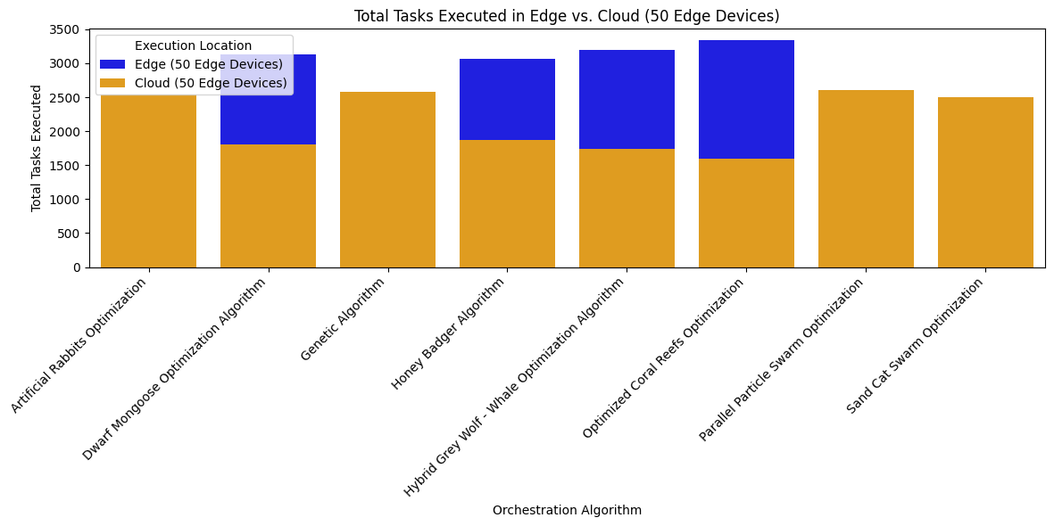
Evaluation
Experiment - Tasks Executed

Slide 8
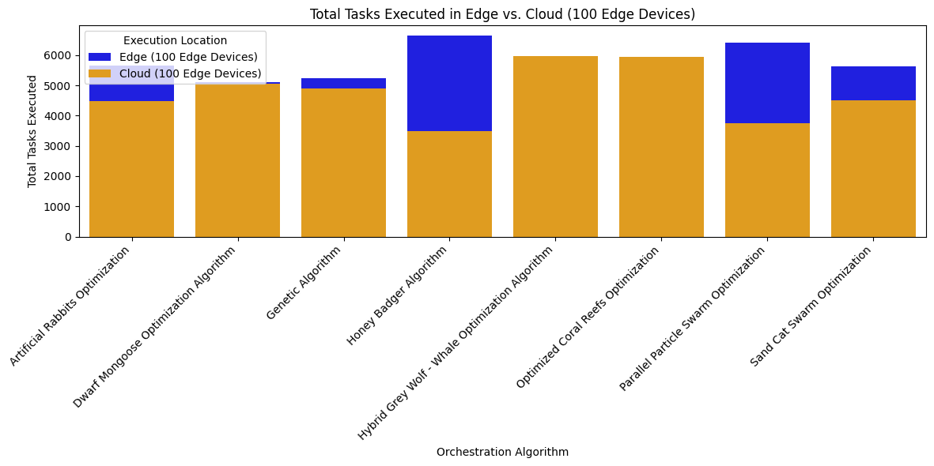
Evaluation
Experiment - Tasks Executed

Slide 9
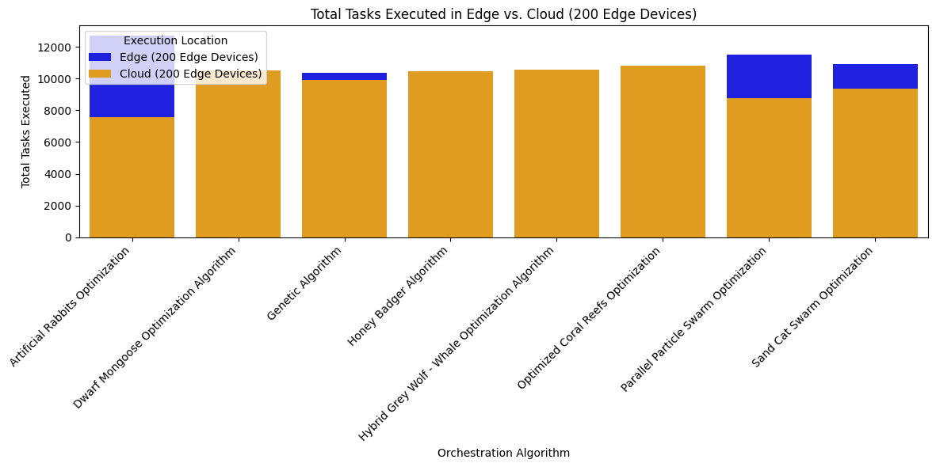
Evaluation
Experiment - Tasks Executed

Slide 10
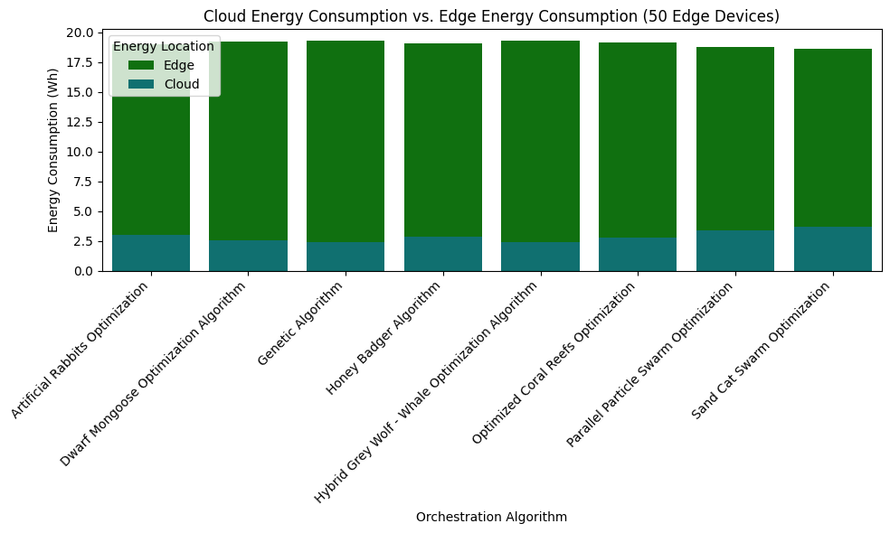
Experiment - Energy Consumption

Slide 11
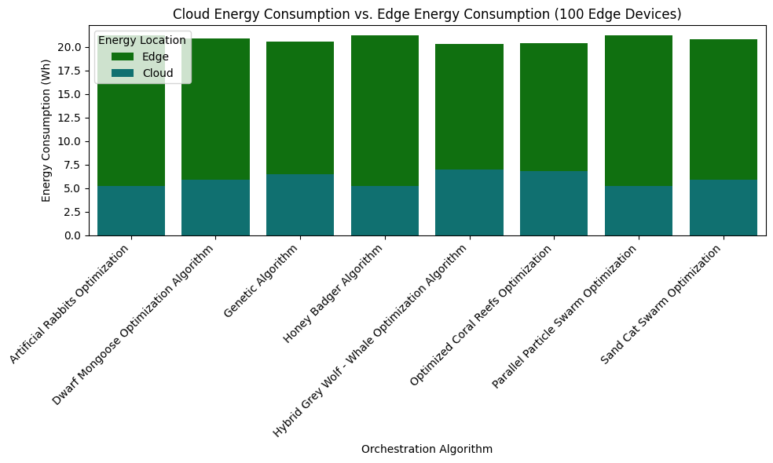
Experiment - Energy Consumption

Slide 12
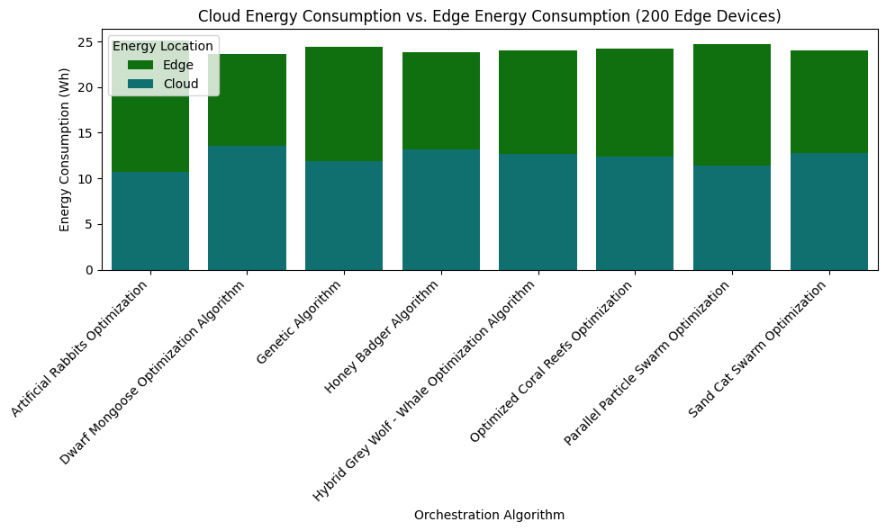
Experiment - Energy Consumption

Slide 13
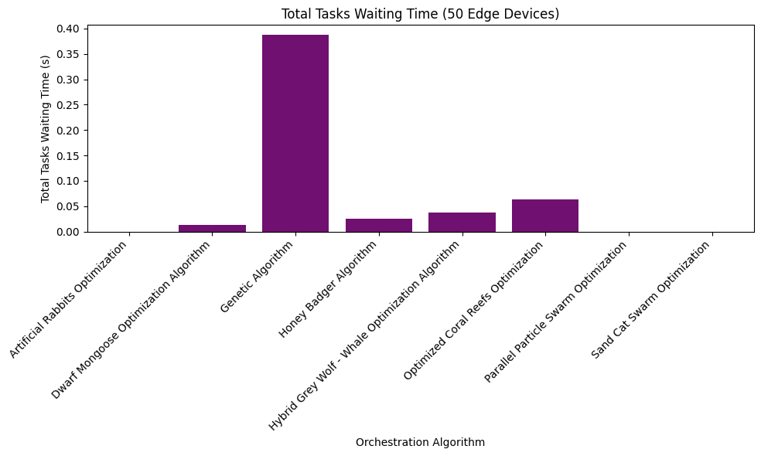
Experiment - Waiting Time

Slide 14
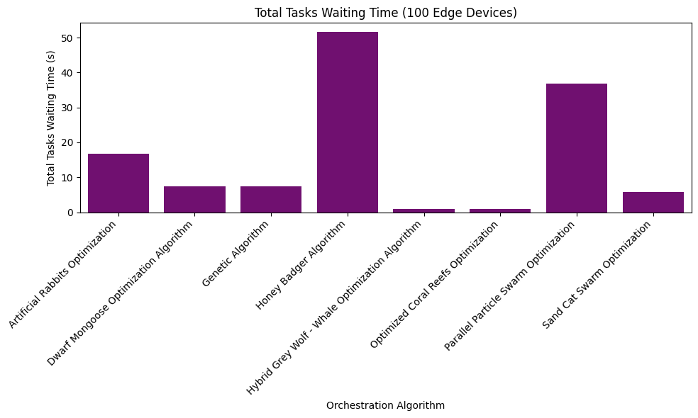
Experiment - Waiting Time

Slide 15
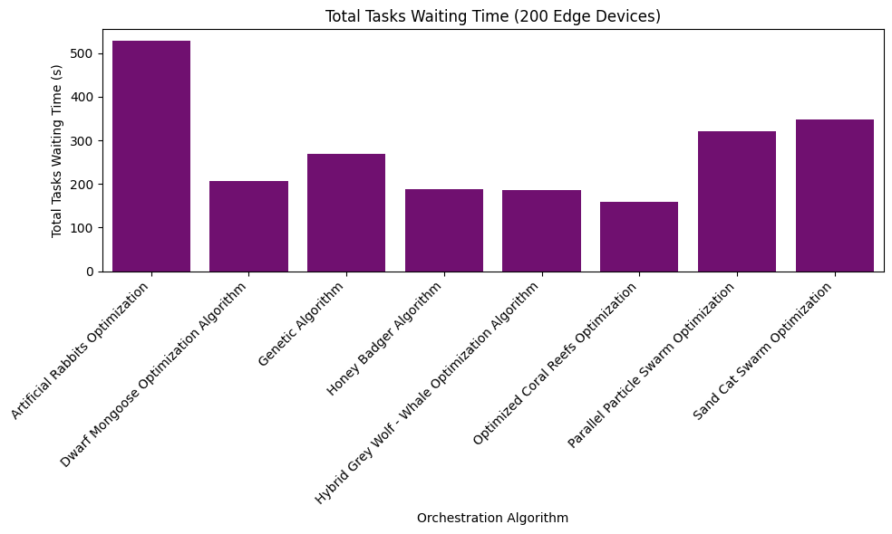
Experiment - Waiting Time

Slide 16
Conclusion
Addressing Challenges
Research Question and Objectives
Thorough Experimentation
Key Findings

